Slide 1
Budget Update
President Virginia Horvath
May 13, 2019

Slide 2
Fredonia’s Budget Situation
PLAN
Reduce expenditures
Stabilize enrollment
Seek new revenue streams
CONSTRAINTS
Demographic shifts (NYS population decline)
Tuition increases determined by legislature (annual, -Excelsior)
Unfunded mandates ($10.1M since 2012): negotiated salary increases and retroactive lump-sum payments
Flat state base operating support

Slide 3
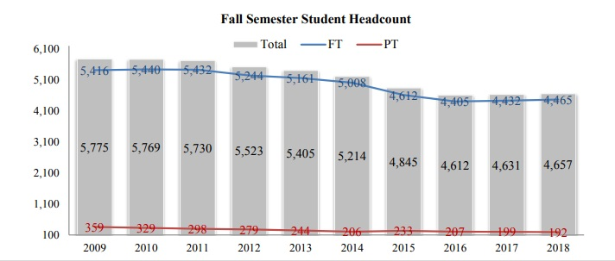
Source: University Fact Book 2018
Institutional Research, Planning, & Assessment

Slide 4
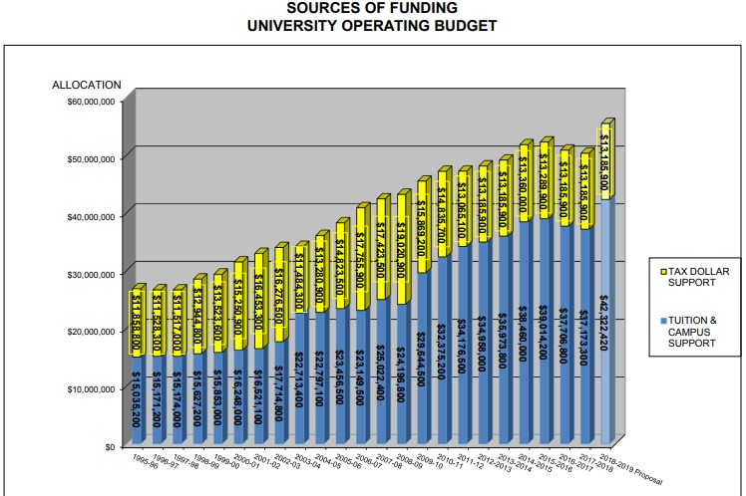
Source: SUNY Fredonia 2018-2019 Budget Book

Slide 5
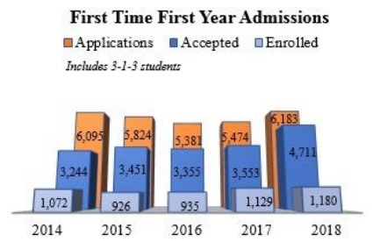
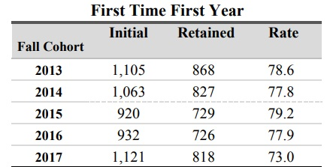

Slide 6
$21.6 M deficit

Slide 7
Previous Actions
2012-2018: more than $9.5M of reductions in continuing expenditures and more than $50M in one-time institutional shortfall actions to address the budget deficit
Reduction of workforce through cautious hiring practices:
  2012: 1,000 employees
  2018: 906 employees
  Reduction of Management/Confidential positions: 24 (2012-13) to 18 (2019-20)
Increased efficiencies (class scheduling, overtime, purchasing)
Reorganizations in all divisions

Slide 11
Budget Plan for 2019-2020
Work begun across all divisions since July 1, 2018
Goal for 2019-2020: reduce ongoing state expenses by $4.5 million
Targets established in each area and modified based on opportunity and need (Cabinet meeting on Wednesday)
Much of the savings are in vacated positions, realignments, and reductions in OTPS expenses

Slide 13
Fredonia Retirement Plan
Goals of the plan: offer an incentive to full-time state employees
177 eligible employees
29 elected to retire
Total salaries of retirees: $2.14 M
Investments in replacements: $535,000
Total recurring salary savings after payouts: $1.6 M

Slide 14
Notes:
Space for 2019-20 budget detail with unfunded balance

Slide 15
Other Planning for 2019-2020
Planned enrollment of 4,700 students for Fall 2019
More than $2M in grants and awards to students and programs through the Fredonia College Foundation in 2018
Residence Halls master planning and Landscaping planning
Rockefeller Arts Center 50th Anniversary Celebration
New investments in Information Technology, including VoIP for phone system; strategic communication systems across campus; creation of a campus Intranet; and upgraded digital signage

Slide 16
Anticipate hiring 16 new tenure-track faculty to begin in Fall 2019
Approval of 15 sabbaticals for 2019-2020
Preparation for reorganization in Academic Affairs (Senate vote today), with 35 people volunteering to serve on planning committees
Interim President and Presidential Search
Middle States Reaccreditation visit

Slide 17
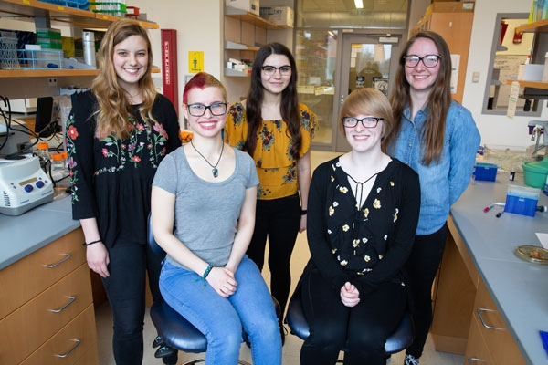
Notes:
Students in the molecular genetics lab

Slide 18

Notes:
Senior show continuing through today in the Marion Art Gallery

Slide 19
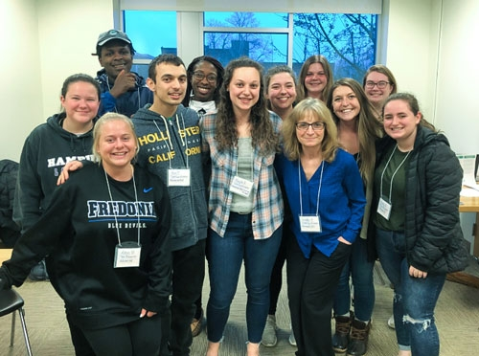
Notes:
Students in VITA program, assisting 575 local residents with income tax returns

Slide 20
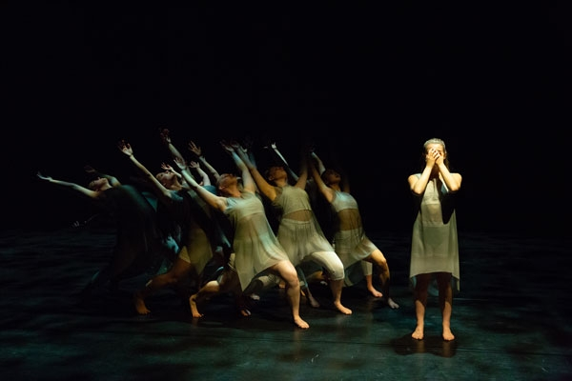
Notes:
Fredonia Dance Ensemble concert May 3-4

Slide 21


Slide 22
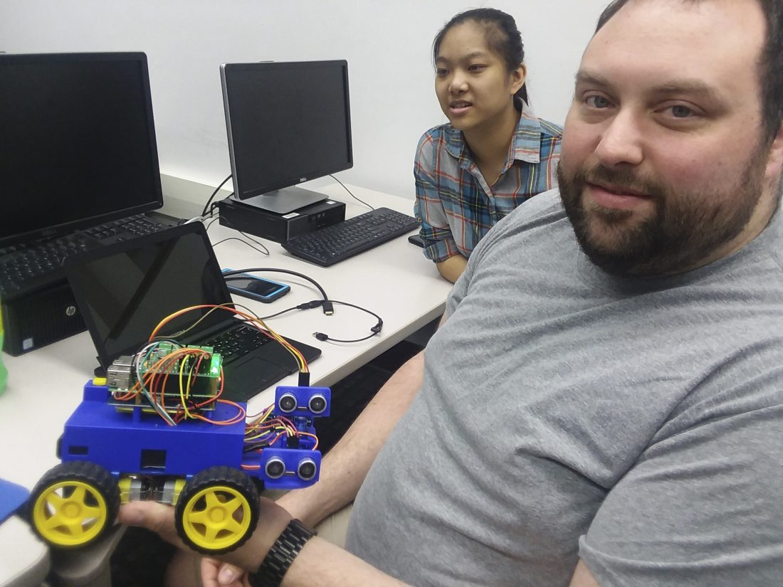
Notes:
Mission and whys Introduction to Robotics course featured in today’s Observer

Slide 23
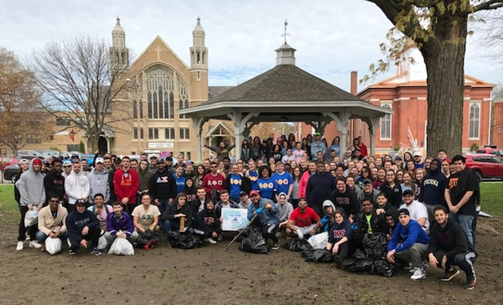
Notes:
More than 100 Student volunteers cleaning up Village of Fredonia streets

Slide 24
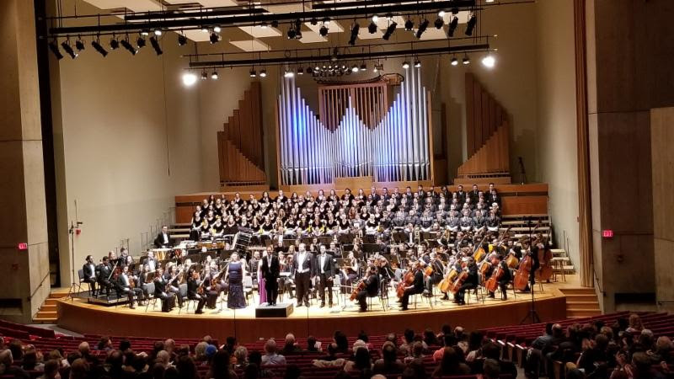
Notes:
Critical mission and investing in students

Slide 25
SUNY Fredonia educates, challenges, and inspires
students to become skilled, connected, creative,
and responsible global citizens and professionals.
The university enriches the world
through scholarship, artistic expression,
community engagement, and entrepreneurship.

