Slide 1
RESIDENCE LIFE LEADER TRAINING
FIRE SAFETY TRAINING
(CONDENSED VERSION)

Slide 2

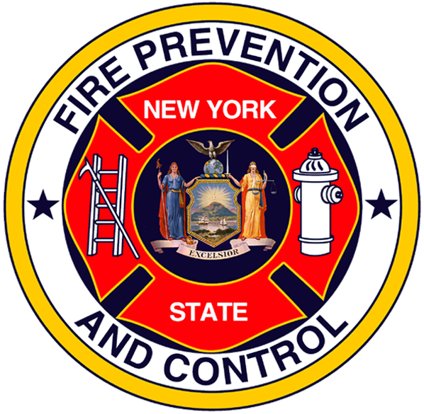
New York State
Division of Homeland Security & Emergency Services
Office of Fire Prevention and Control

Slide 3
OBJECTIVES:
  Upon completion of this workshop the residence life leader will understand:
  The critical nature of campus fire safety education.
  The role of residence life leaders in fire safe campus life.
  The elements of motivating students to adopt a fire safe lifestyle.

Slide 4
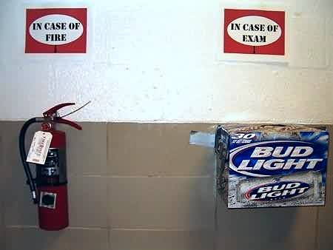
WE HAVE A PROBLEM…
The college fire problem is real.
Through continual education, losses can be reduced.
Most college safety violations are caused by behavior.

Slide 5
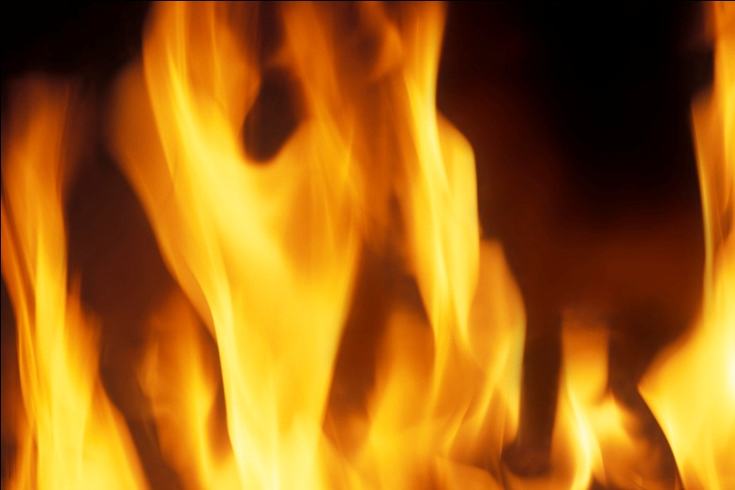
The College Fire Problem:
In New York State:
  Over 300 Campus fires reported each year
  Approximately 160 of these are in dormitory units
  Numbers likely higher due to unreported fires
  Numbers do not include off-campus fires

Slide 6
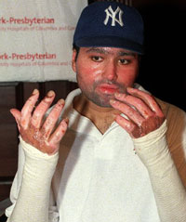
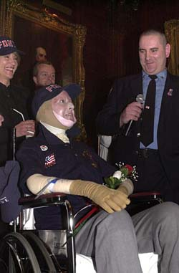
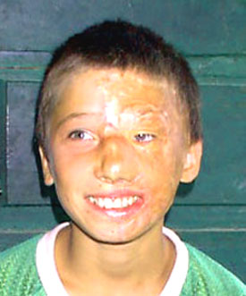
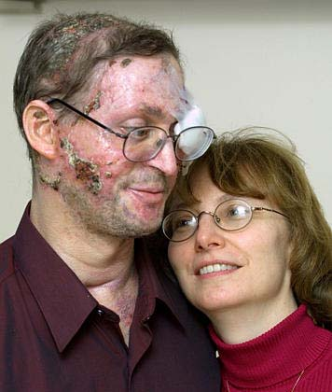
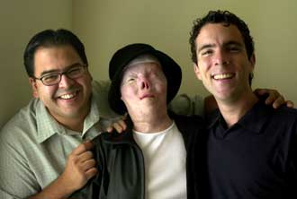
When fires do occur,
When deaths and disfiguring burn injuries result, the consequences last forever.
Notes:
6
Click mouse for first picture. The remaining 4 will appear automatically.

Slide 7
The campus life safety hazard can be great at any time of the day
Varied class attendance schedules
Sleeping in dorms or residences at all hours
Up at all hours studying or socializing
Huge complexes may have minimal exiting options
Accountability can be extremely difficult
Training is often weak or non-existent

Slide 8
Roles and Responsibilities:
Who’s Job is it?
Everyone on Campus has some role in maintaining and promoting a fire safe environment:
  Administration
  Buildings and Grounds
  Environmental Health & Safety
  Residence Life Staff
  Students

Slide 9
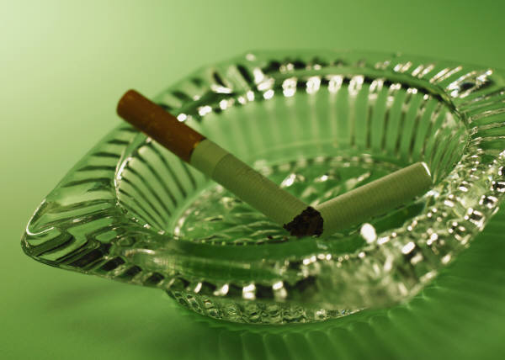
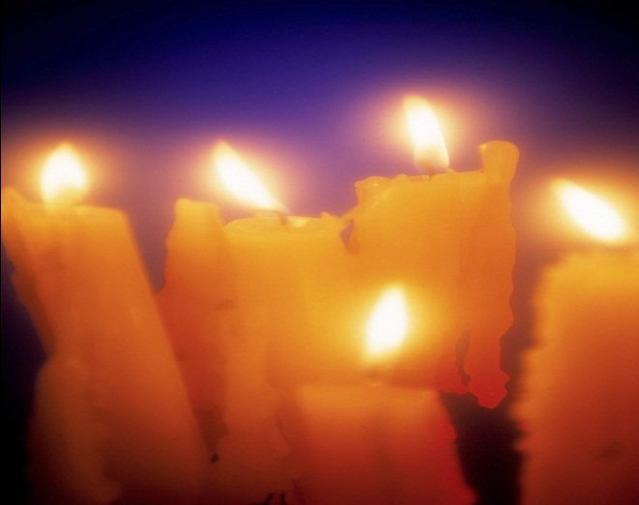
Roles & Responsibilities…Behavior
Most college fire safety violations are due to BEHAVIOR
People doing dumb things whether knowingly or not.

Slide 10
Roles & Responsibilities--
Resident Life Leader’s Role:
Behavioral Issues is where the Residence Life Leader has the GREATEST IMPACT for change.
  Live in Campus Housing
  Near daily contact
  Peers
  Viewed as a Leader and a Counselor
  Can explain the importance of safety issues encountered and the dangers to self and others

Slide 11

Roles and Responsibilities
New York State Office of Fire Prevention and Control
  Fire Safety Inspections
  Training
  Technical Support
RESIDENCE LIFE STAFF AND OFPC SHARE COMMON GOALS!

Slide 12
Training:
Many adults are under-educated in fire safety.
  Causes of fires
  Fire Behavior
  What to do in case of fire

Slide 13
Training:
Attitude and Experience
Many students are away from home for the first time:
First taste of Independence
Feelings of Invincibility or Immortality
Do not have the maturity or life experiences and do not recognize threats to their safety
Do foolish or dangerous things without realizing the consequences to themselves and others

Slide 14
Training:
When a fire occurs:
  There is NO time to think up an action plan
  Flames, smoke impede exits, especially if designed safety systems are compromised.
  Lower oxygen levels impair brain function

Slide 15
As a Residence Life Leader, you must Educate and Motivate students on fire safety in a way that focuses on changing their behavior

Slide 16
Residence Life Leaders’ Role in Fire and Safety Training:
Planning, Commitment, and Persistence
Ongoing, Informal Student Training and Motivation:
  Floor Meetings
  Casual Conversation
  Competitions
  Fire Safety--All The Time, Everywhere!

Slide 17
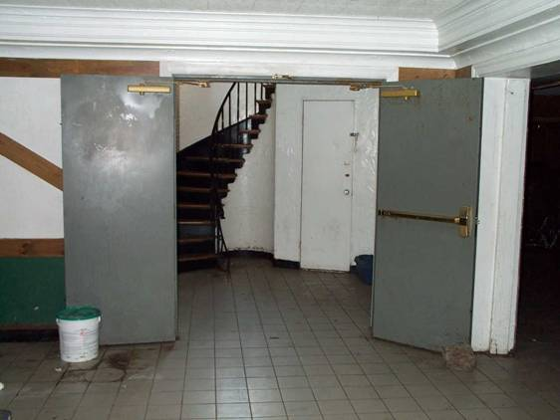

Motivating Students to a Fire-Safe Behavior
Room Inspections
  Announced
  Unannounced
Day to Day Observations
Reports of Unsafe or Hazardous Conditions
Follow up on any potentially hazardous situation

Slide 18
The Role of Residence Life Leaders in Campus Fire Safety
Reinforce, support, and enforce specific campus policies

Slide 19
Motivating Students
Be clear, firm, and consistent in what behavior is expected
Develop good peer pressure
  instill floor/dorm/institution pride in fire safe behavior
Continually emphasize the importance of fire safety
Emphasize that one person’s behavior impacts the safety of others

Slide 20
Motivating students
Set floor, dorm, and college-wide safety goals
  make them challenging but achievable
  include and emphasize drill participation
Use positive reinforcement more than negative punishment
  notice good fire safety behavior
  give immediate positive feedback
  consider citations and visible rewards

Slide 21
BEHAVIORAL ISSUES ARE WHERE YOU CAN MOST MAKE A DIFFERENCE

Slide 22
Resources for the Residence Life Leader:
Student Handbook
Fire/Life Safety or EH&S
“Campus Fire Safety” Bulletins (www.campusfiresafety.org )
Local Fire Department
New York State OFPC
  www.dhses.ny.gov/ofpc/publications

Slide 23
Summary:
College Campuses Have Unique Fire Safety Concerns
Most Common Fire Safety Hazards are Due to Behavior
If All Parties Involved Commit to Fire Safety, It Can Happen
You are the Person Best Suited to Teach Your Residents Fire Safe Behavior

Slide 24

Get them here safely!

Slide 25
QUESTIONS?

Slide 26
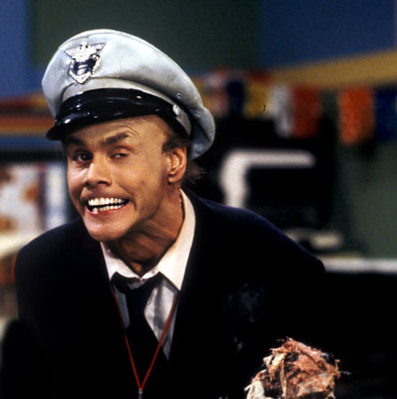

ASK THE FIRE MARSHAL

Slide 27
Fire Drills
Required by NYS Education Law and NYS Fire Codes
Must Be Taken Seriously
Fire Drill or Real Thing?
Problems:
  Accountability
  Accuracy
  Time of Day

Slide 28
The Fire Inspection:
Suites and Rooms randomly selected.
Inspection limited to “plain view” items.
Most room inspections take less than one minute. (More time may be needed when violations need to be removed.)
When possible, code violations are to be corrected or removed immediately.
1st and 2nd re-inspection to verify violation has been abated.

Slide 29
Curtains, Tapestries & Posters:
[F]807.1 In dormitories, curtains, draperies, hangings and other decorative materials must be flame resistant or non-combustible.
  Vertical surface allows for fast flame spread.
  Curtains, drapes and posters generally lightweight.
  Allow in limited quantities…10% rule.
  Keep space between posters.
  Spray-on flame retardants???

Slide 30
Extension Cords:
[F]605.5 Extension cords shall not be a substitute for permanent wiring.
  Designed to serve one portable appliance.
  Shall not be run under doors, floor coverings, or piles of clothes.
  Extension cords generally light gauge, light amperage load.
  Overheating issues

Slide 31
Holiday Lights:
[F]605.9 Temporary wiring methods shall be in accordance with Ch. 27 of the Building Code of NYS (NEC)
  String lights considered temporary wiring
  Many same issues as extension cords
    Lightweight wire gauge
    End to End connections increase potential for overcurrent situation
    Subject to physical damage from installation methods or location

Slide 32
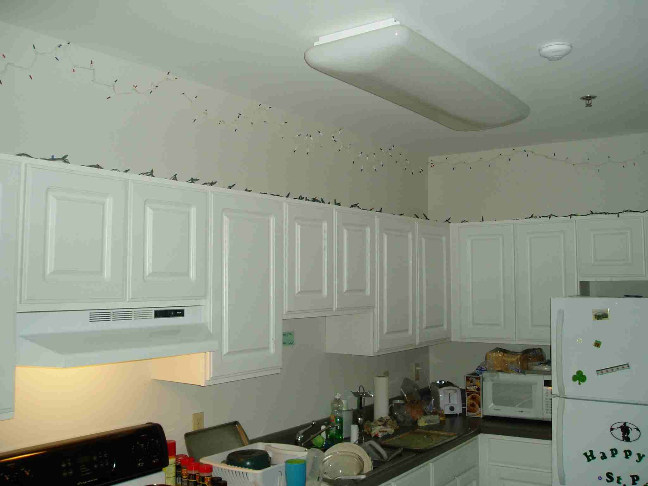

Slide 33
Candles:
[F]308.3.2 Open flame from candles shall not be located on or near combustible material.
[F]308.3.8 Candles, incense and open flame-producing items shall not be allowed in sleeping units of R-2 dormitory occupancies.

Slide 34
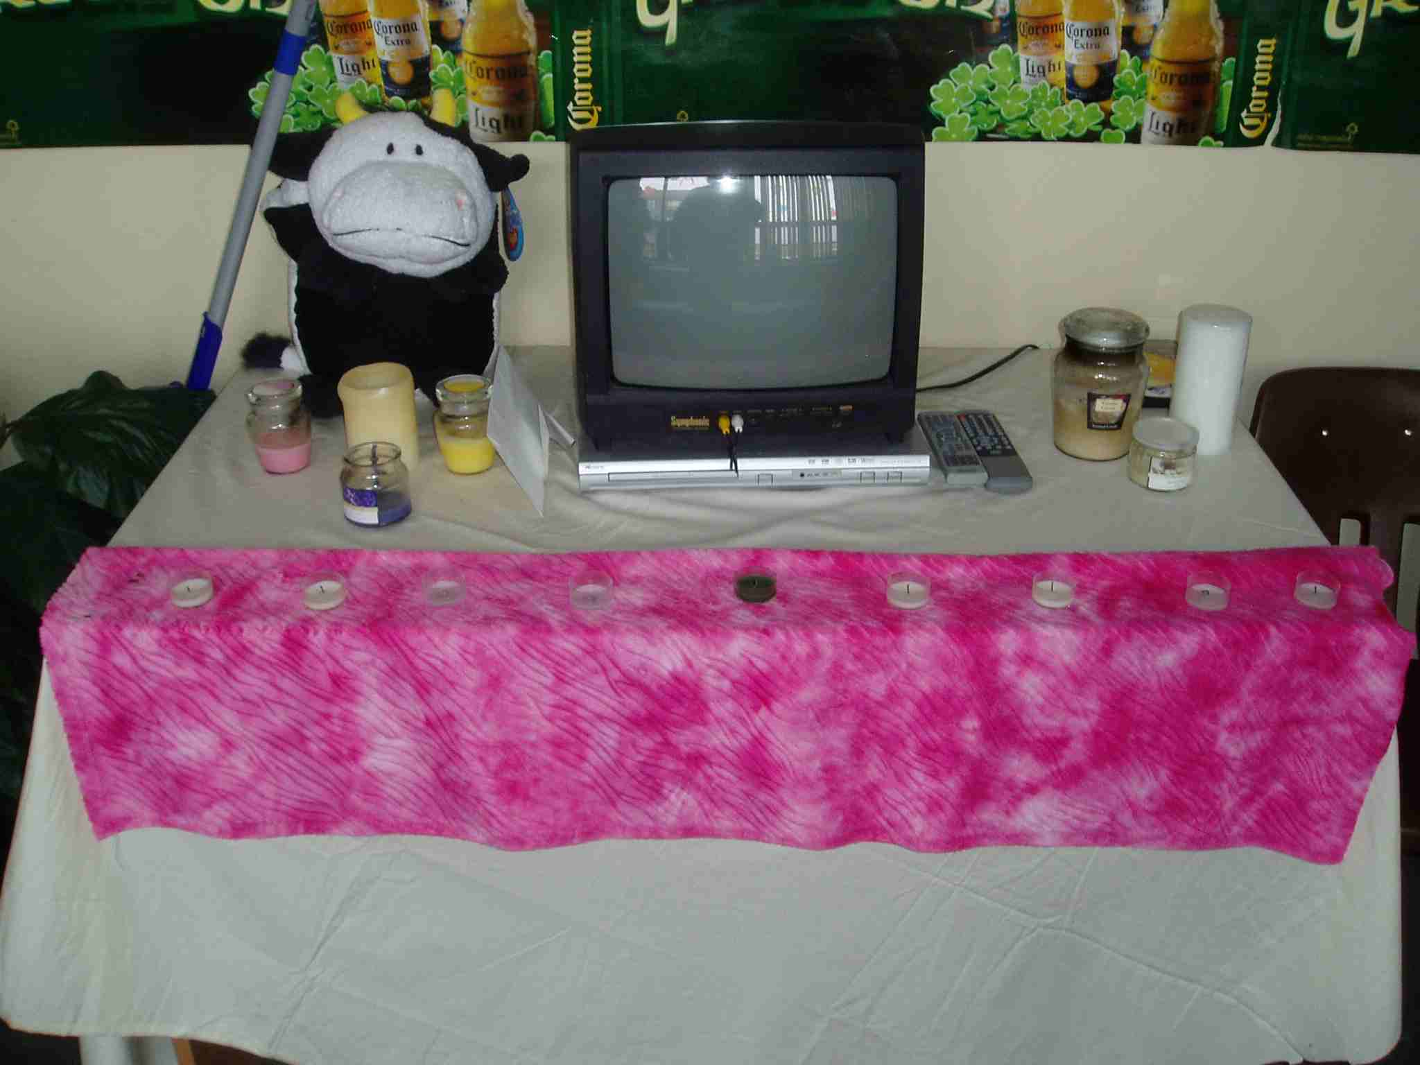

Slide 35
Exits, Means of Egress:
[F]1027.2 Exit access, exit and exit discharge shall be free from obstructions and shall provide full instant use.
  Furniture, etc.
[F]1027.3 Means of egress shall be free of obstructions
  Shoes, clothing in suite halls.
[F]1027.4 Furnishings, decorations or other objects shall not be placed to obstruct exits or visibility thereof.
  Curtains, beads, furniture, etc.

Slide 36
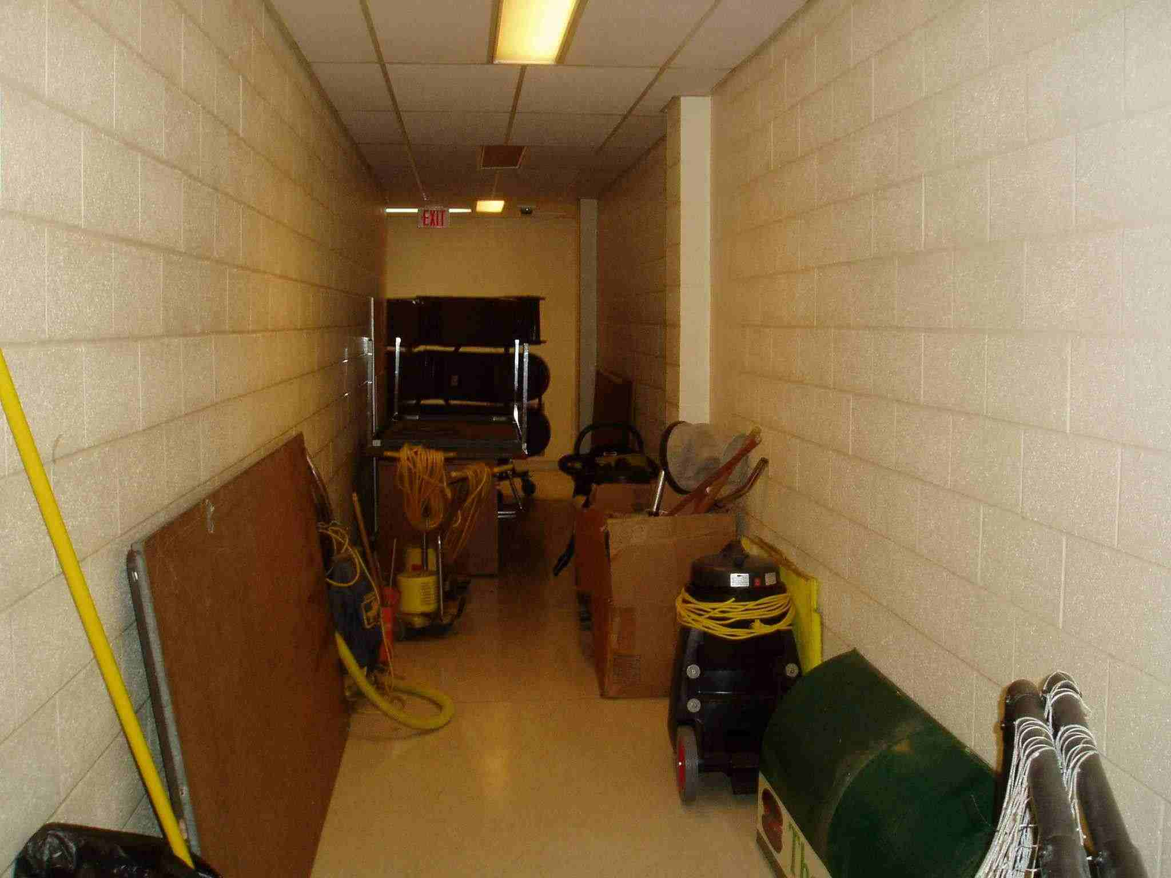

Slide 37
Halogen Lamps:
[F]305.1 Clearance between ignition sources and combustible materials shall be maintained in an approved manner.
  Torchiere style lights
  Desk lamps
    Bulbs can reach 600 degrees F
    Desk lamps usually identifiable by stand-off or handle.

Slide 38
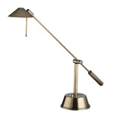
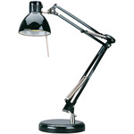

Slide 39
Cooking:
[PM]403.3 Cooking shall not be permitted in any rooming unit or dormitory unit, and a cooking facility or appliance shall not be permitted to be present in a rooming unit or dormitory unit.
  Exceptions: Devices such as coffeepots and microwaves shall not be considered cooking appliances.

Slide 40
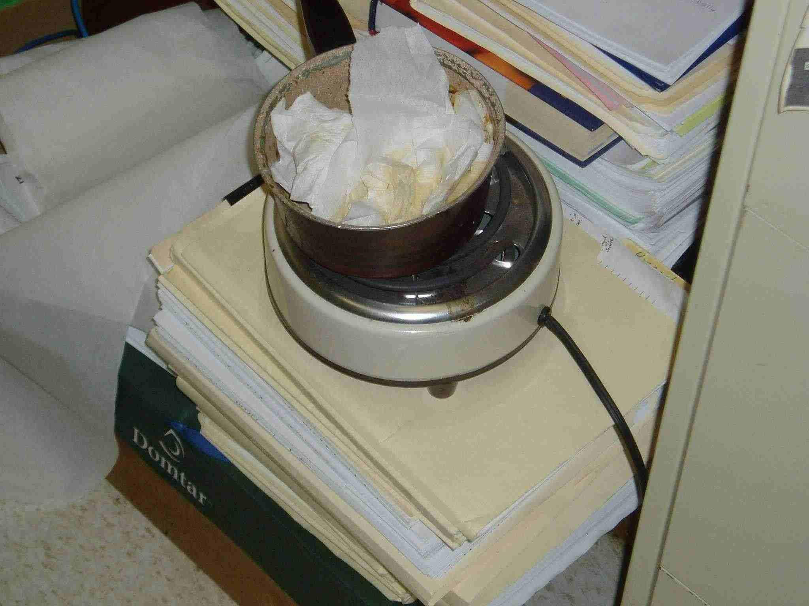
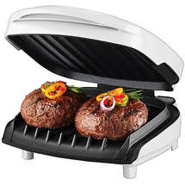

Slide 41
Power Strips:
[F]605.4 Multiplug adapters, such as cube adapters and unfused plug strips shall be prohibited.
[F]605.4.1 Relocatable power taps shall be equipped with overcurrent protection.
[F]605.4.2 Relocatable power taps shall be directly connected to a permanently installed receptacle.

Slide 42
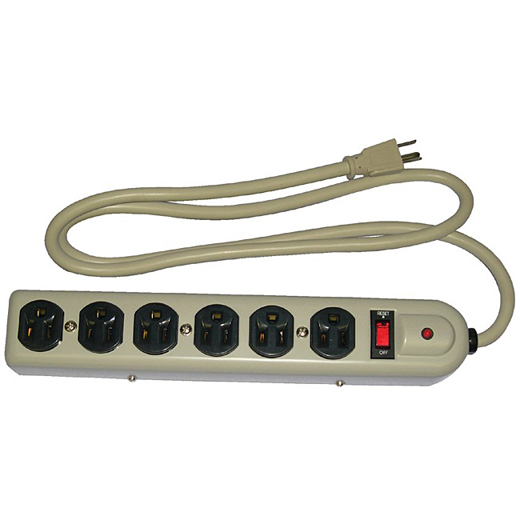

Slide 43
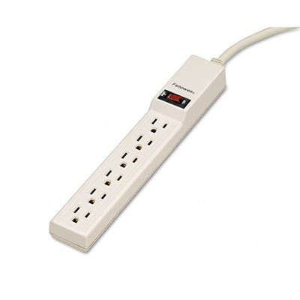

Slide 44
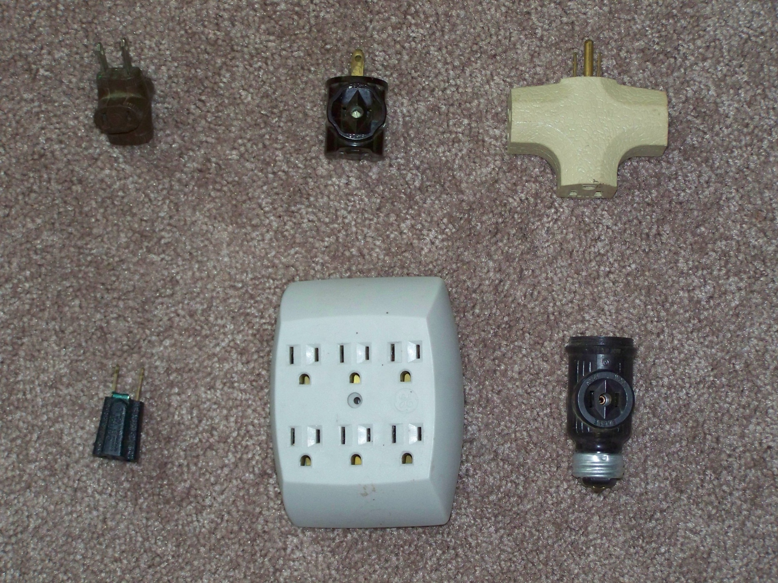

Slide 45
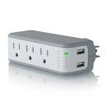

Slide 46
Unapproved Electrical Conditions
[F605.6] Open junction boxes and open wiring splices shall be prohibited. Approved covers shall be provided for all switch and electrical boxes.
[F]605.7 Electrical appliances and fixtures shall be tested and listed…by an approved agency.

Slide 47
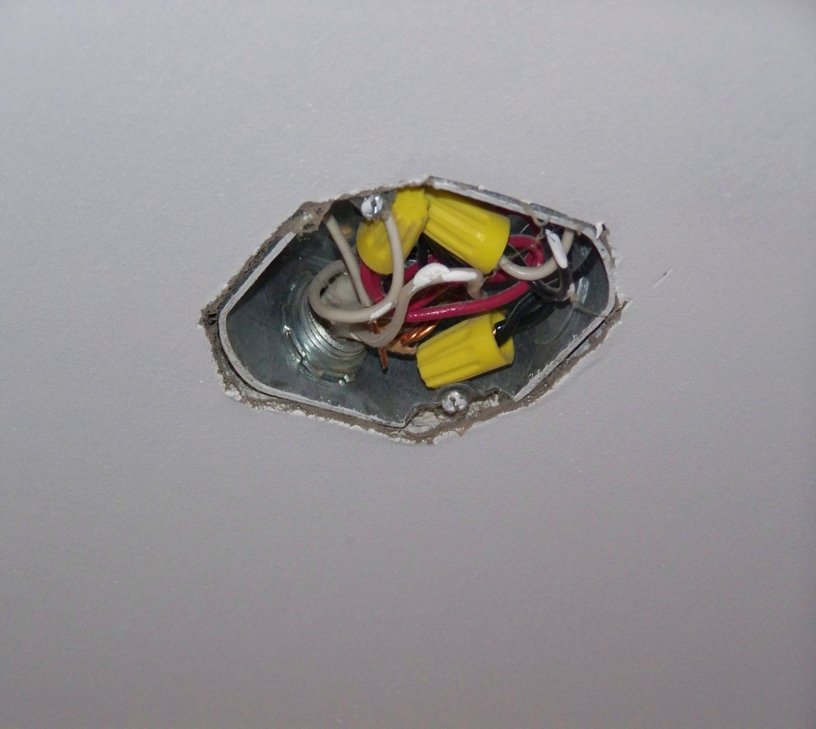
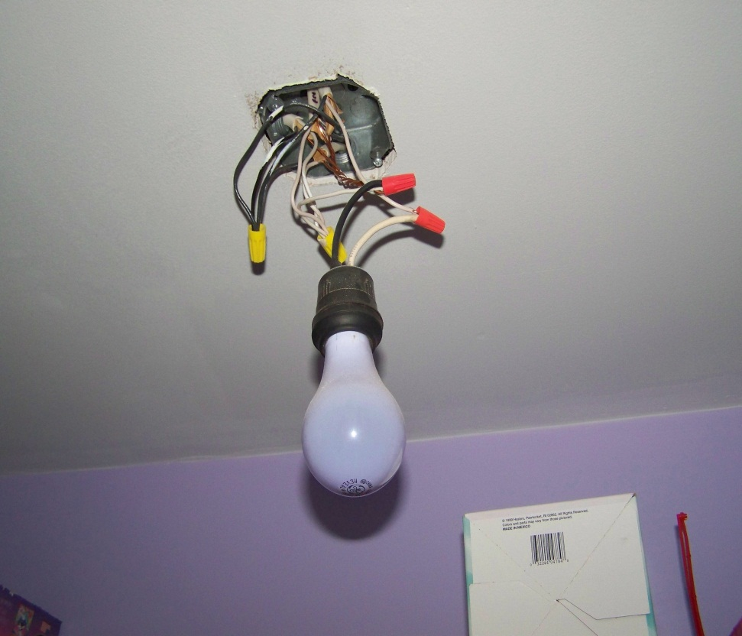
Open Boxes/Splices

Slide 48
Electrical Hazards
[F]605.1 Electrical wiring, devices, appliances and other equipment that is modified or damaged and constitutes an electrical shock or fire hazard shall not be used.

Slide 49
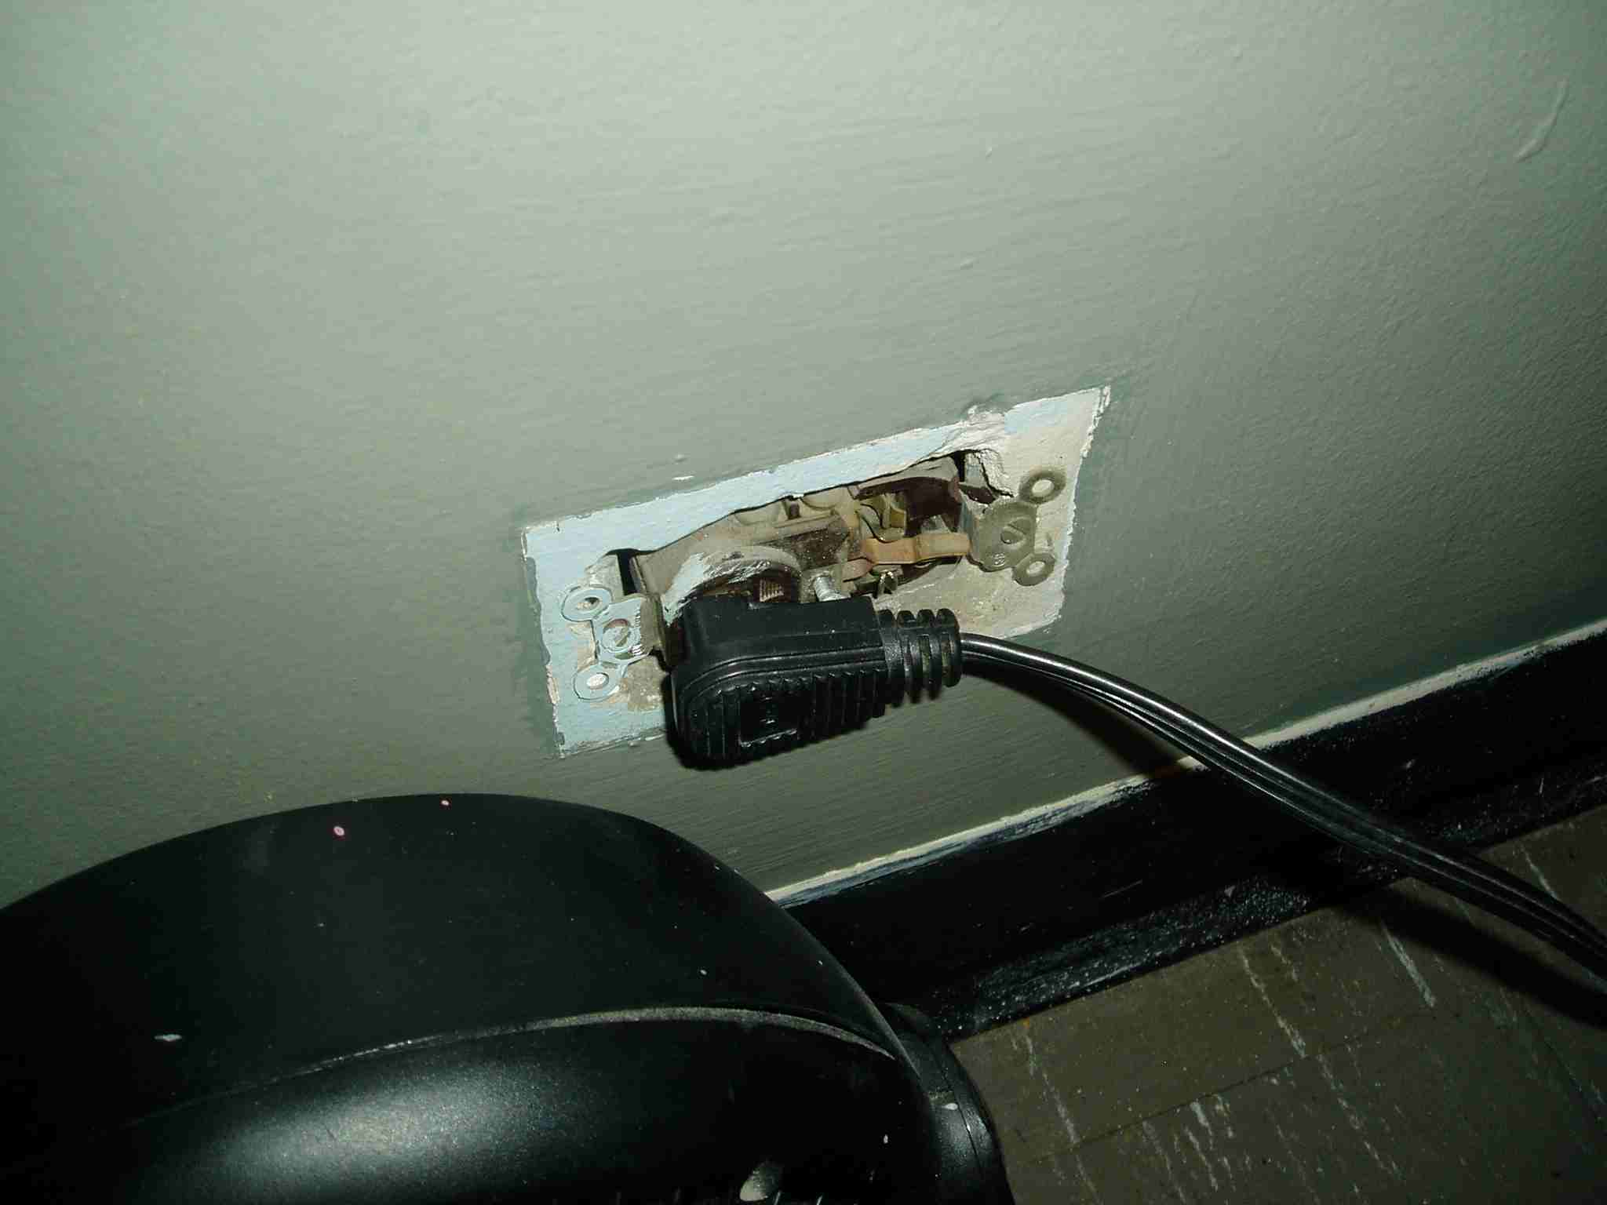
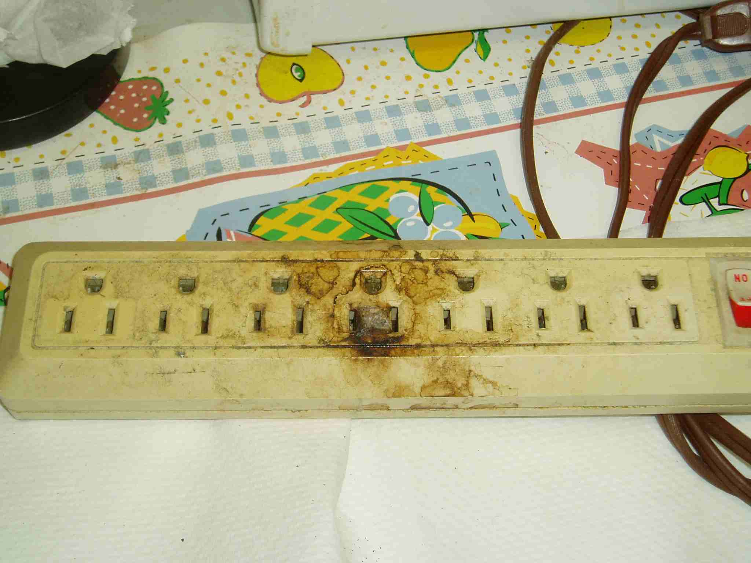
Electrical Hazards-Damaged Equipment

Slide 50
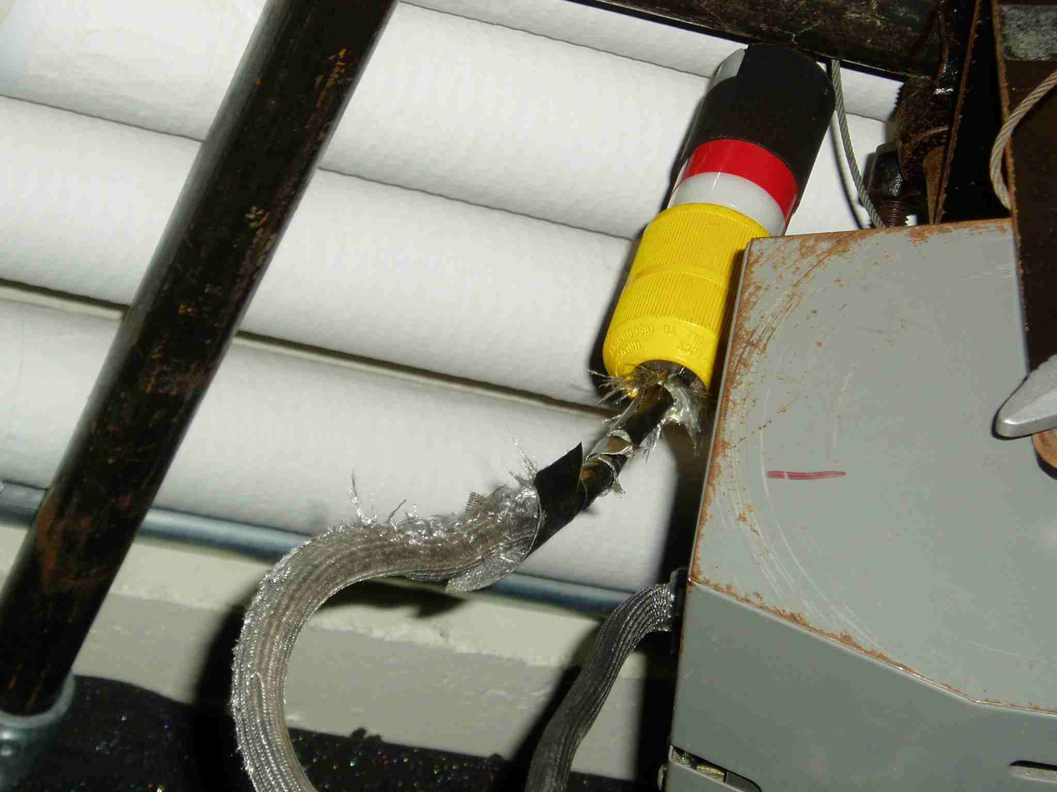
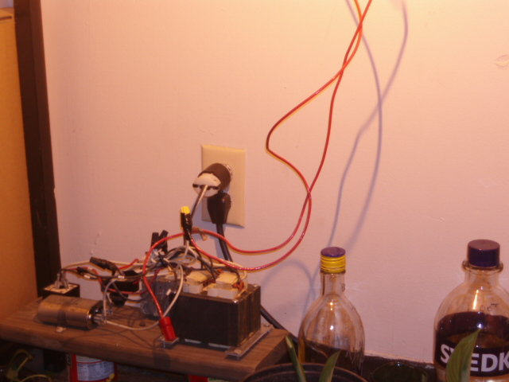
Electrical Hazards:
Damaged or Modified Equipment

Slide 51
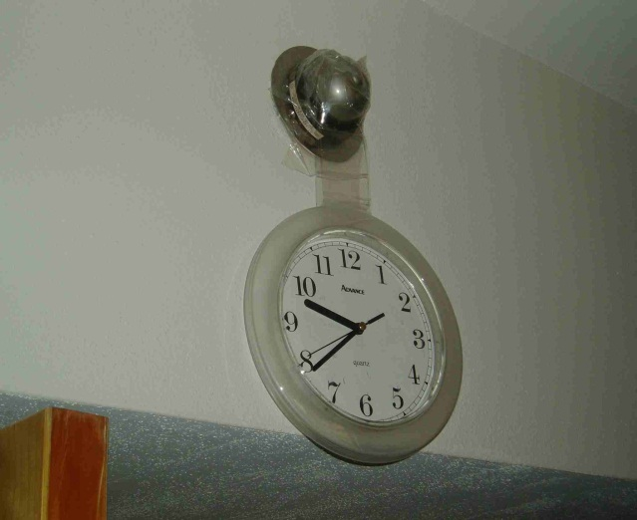
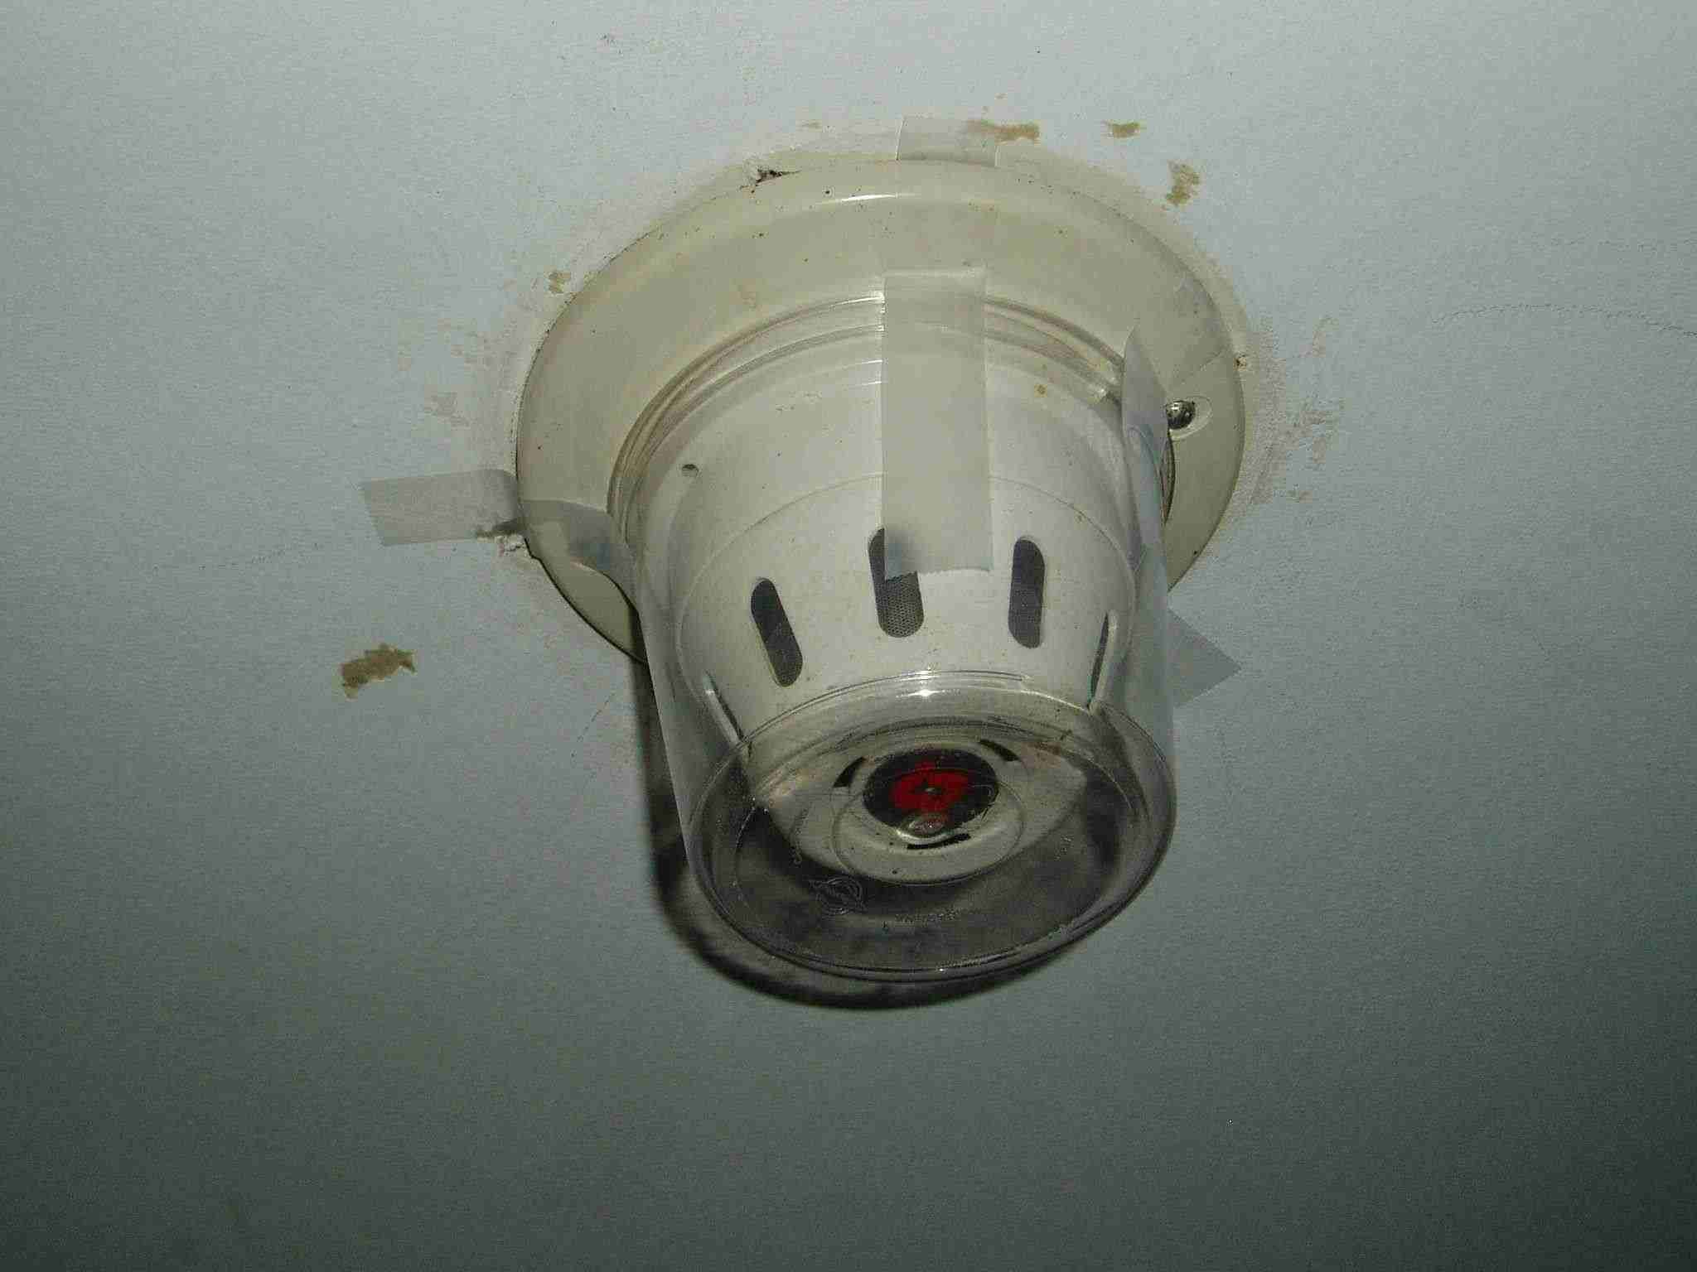
Removal or Tampering with Equipment:
[F]901.8 It shall be prohibited for any person to remove, tamper, or otherwise disturb any fire detection and alarm system, suppression system, or other fire appliance.

Slide 52
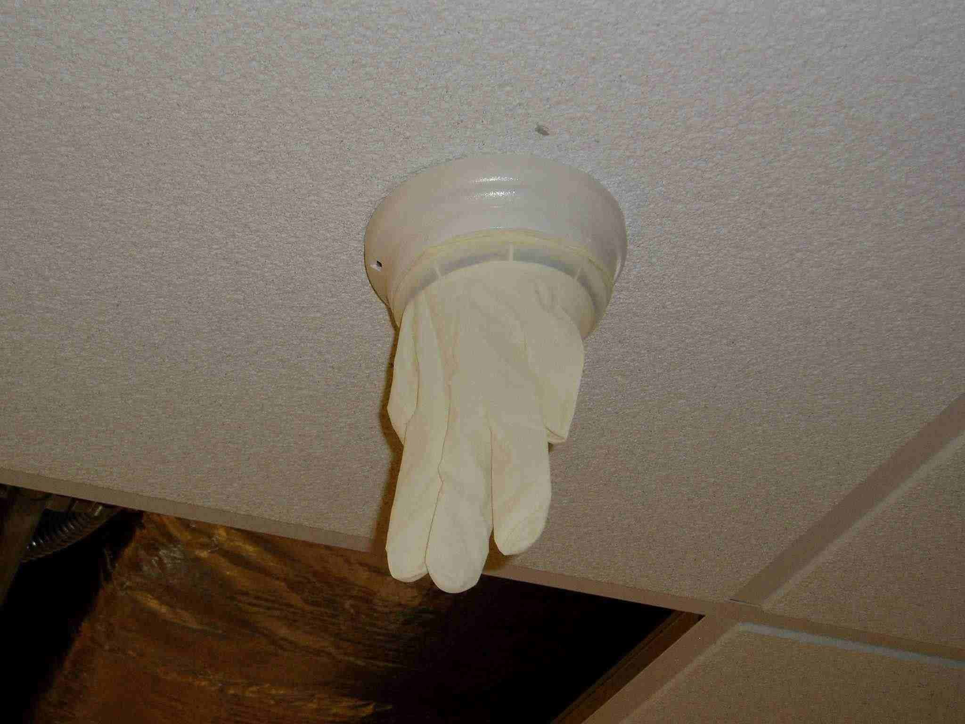
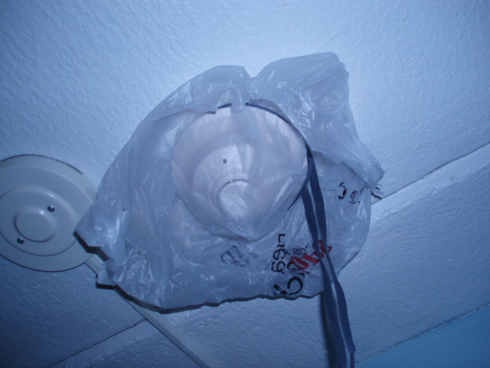
Tampering with Equipment

Slide 53
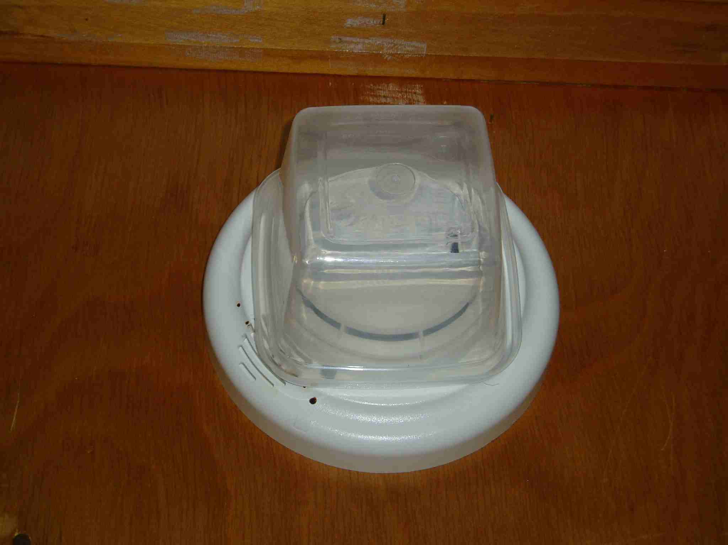
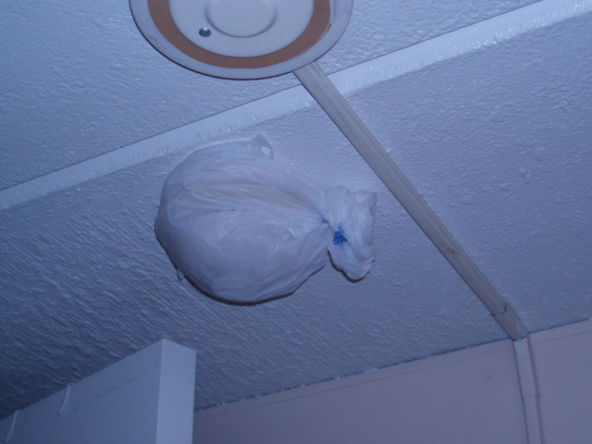
Tampering with Equipment

Slide 54
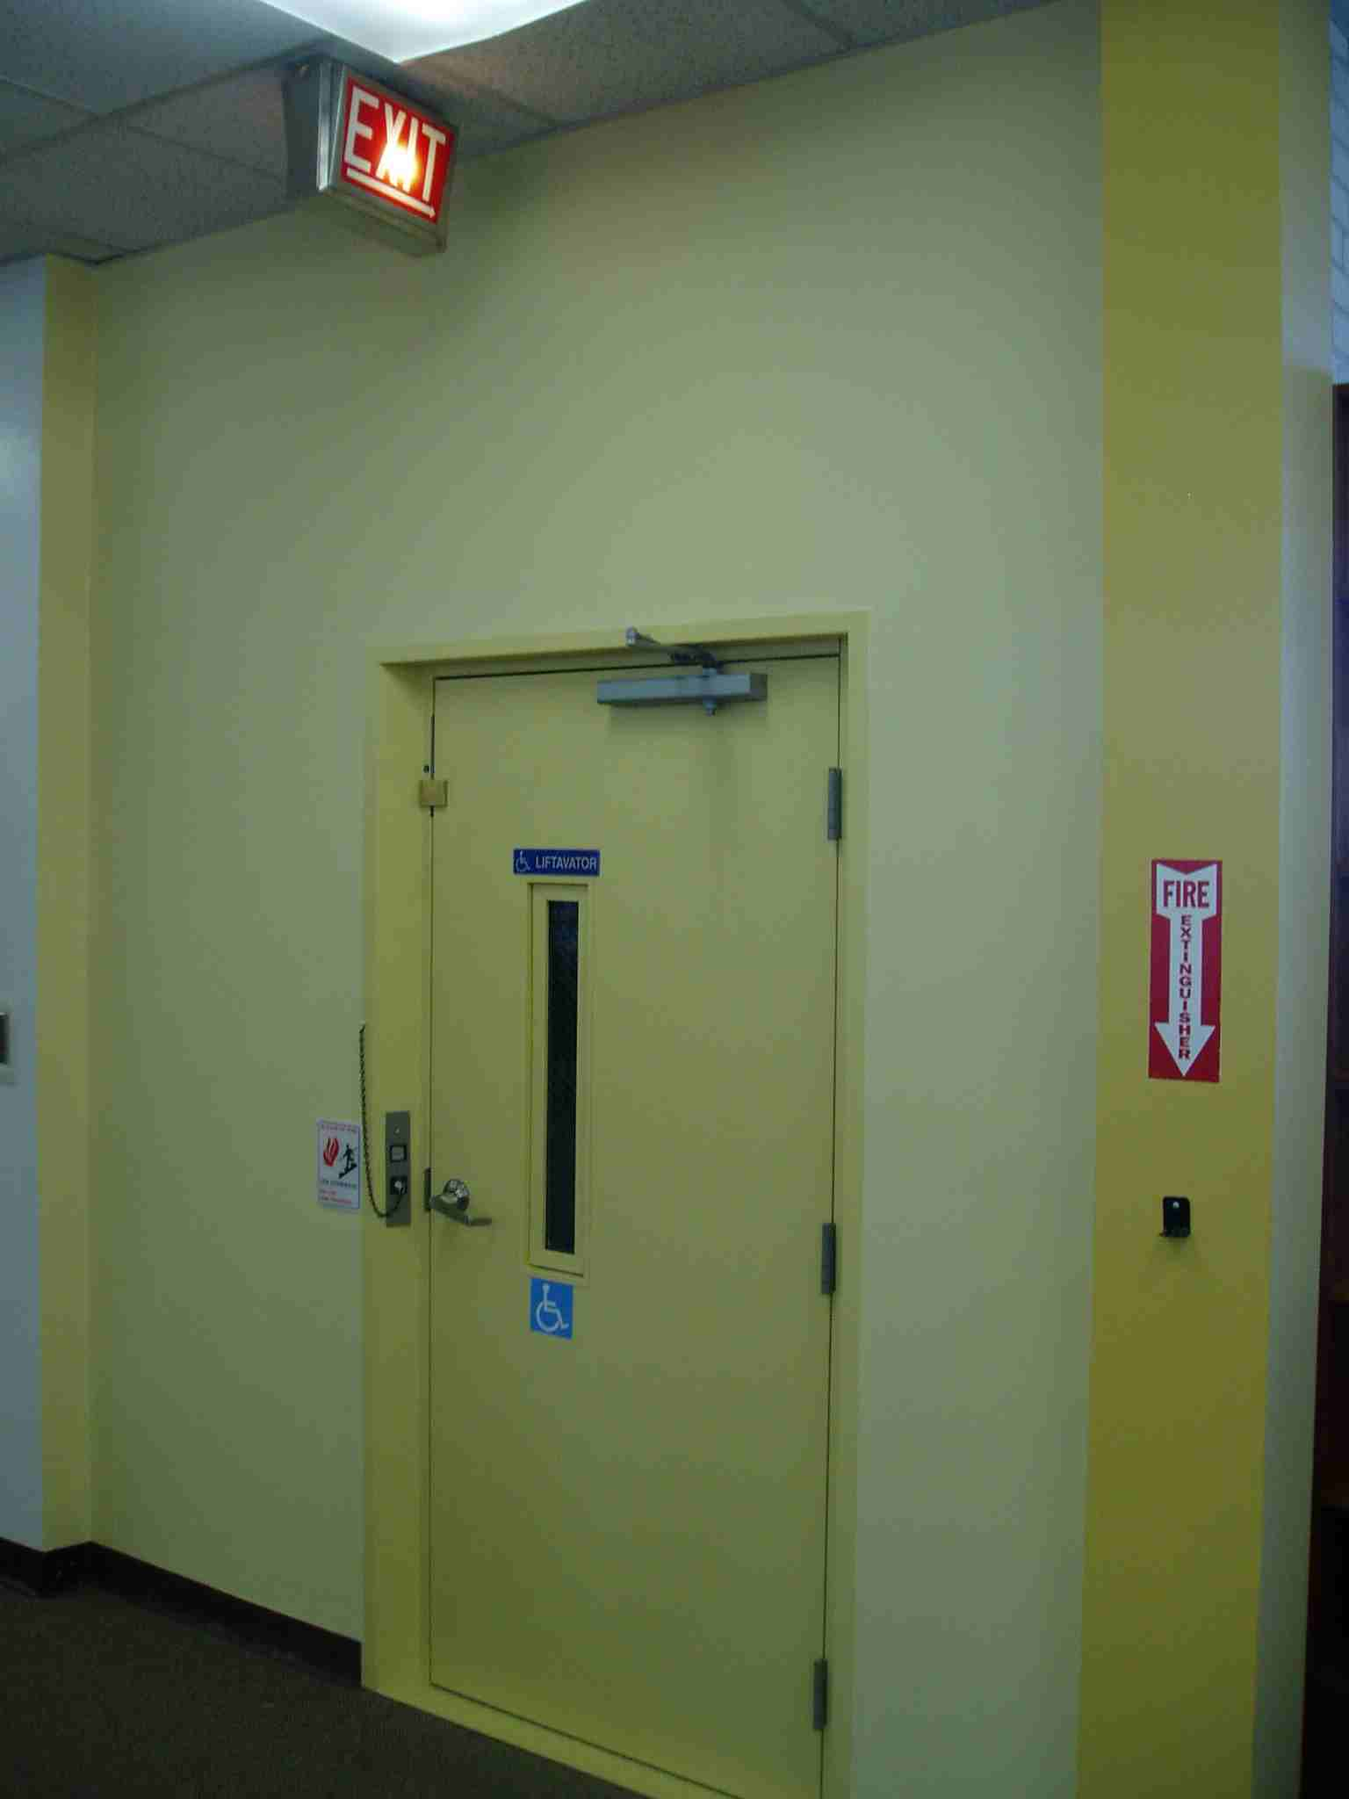
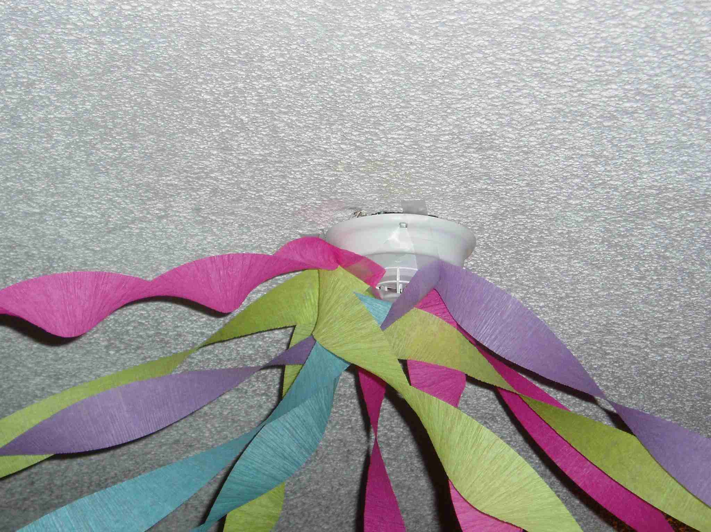
Tampering with Equipment

Slide 55
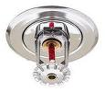
Sprinkler Heads:
Do not suspend objects from sprinkler piping, brackets or heads.
Maintain 18” clearance from sprinkler head deflector to storage below.

Slide 56
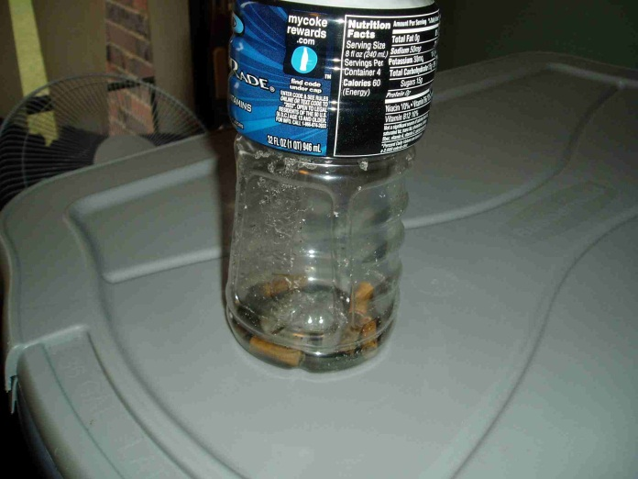
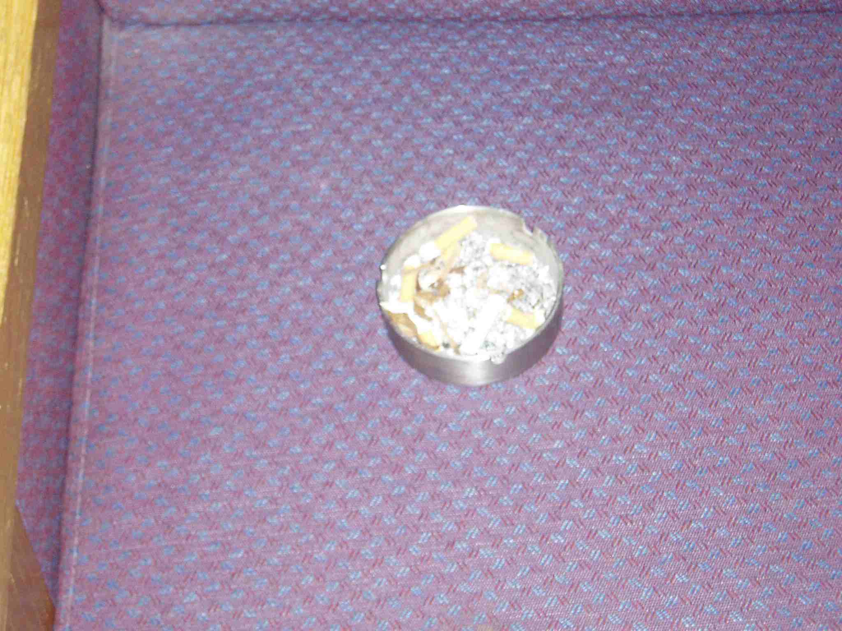
Smoking
[F]310.2 Smoking shall be prohibited (in prohibited areas.)

Slide 57
Combustible Storage:
[F]304.1 Combustible waste material creating a fire hazard shall not be allowed to accumulate in buildings or structures.
[F]315.2.2 Combustible materials shall not be stored in exits or exit enclosures.

Slide 58
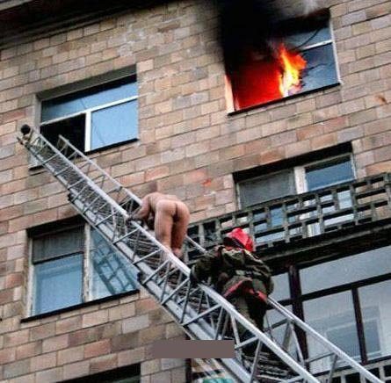
The End

Slide 59
QUESTIONS ???

